Slide 1
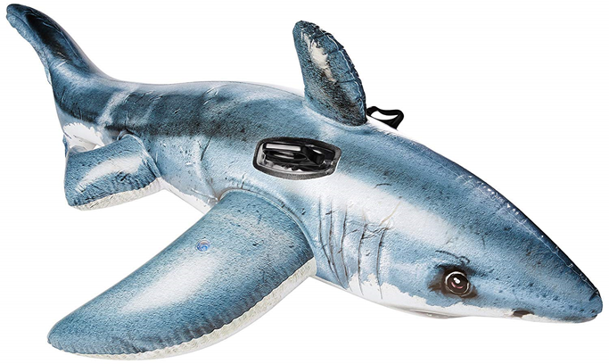



Slide 2
Week Overview
DAY 1 | Import & data analysis
DAY 2 | Business decision & start cleaning process
DAY 3 | Applying aggregation and filtering techniques
DAY 4 | Merging the code, adding graphics & preparing presentation

Slide 3
Data Wrangling and Cleaning
Challenges
Unnecessary Columns: Removed source, pdf, href formula.
Formatting Issues: Inconsistent text (e.g., country names, gender values).
Critical Null Values: Missing data in Age, Sex, Species.
Undefined Categories: Ambiguous entries in Fatal Y/N and Sex.
Duplicates: Redundant rows inflated the dataset.
Filtering: Activities that requires neoprene
Solutions
Remove unnecessary columns
String Cleaning:** Used Python libraries like `str.lower()` and regular expressions to standardize text column.
Reduce date set from 2000 to 2025
Age: Replaced missing values with group-based medians
Dropped missing values rows and duplicate values rows
Handling Undefined Values:** Grouped unknown categories into "Unknown" to maintain clarity while avoiding bias.
Creating a list with the activities requiring neoprene from Data and applying filter
The main problems that we find working with this database was:
Some columns with not useful information (source, pdf, href formula…)
Formatting issues (some countries were in capital letters others not, some gender values has extra spaces)
Old values
Critical columns like "Age," "Sex," and "Species" had a significant number of null values
Missing values
Undefined Categories:** "Fatal Y/N" and "Sex" contained undefined or ambiguous categories.
Duplicates rows that inflated the dataset
Solution:
We remove columns we were not going to use.
String Cleaning:** Used Python libraries like `str.lower()` and regular expressions to standardize text column.
Reduce date set from 2000 to 2025
Age: Replaced missing values with group-based medians (e.g., by country or activity type) to preserve trends.
Reduce date set from 2000 to 2025
Dropped missing values rows and duplicate values rows
Handling Undefined Values:** Grouped unknown categories into "Unknown" to maintain clarity while avoiding bias.

Slide 4

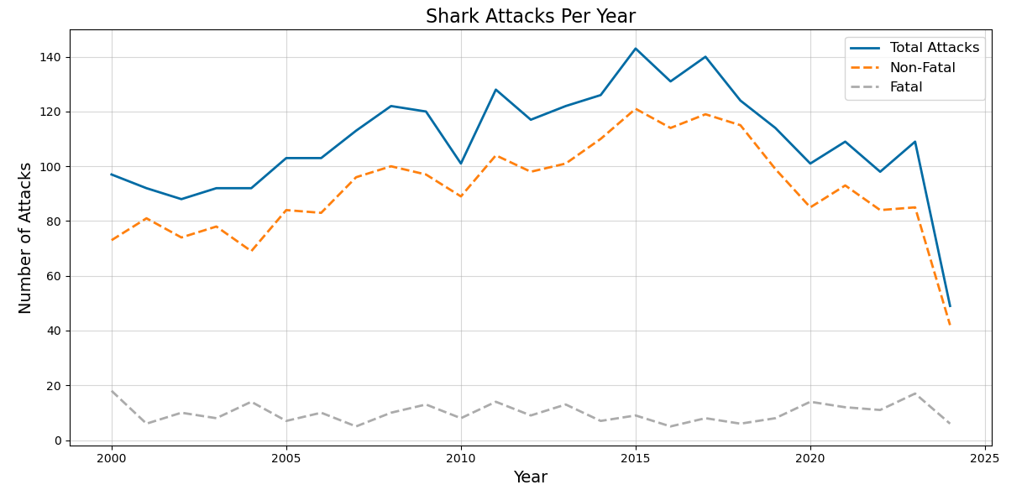
YOU ARE NOT SAFE!

Slide 5
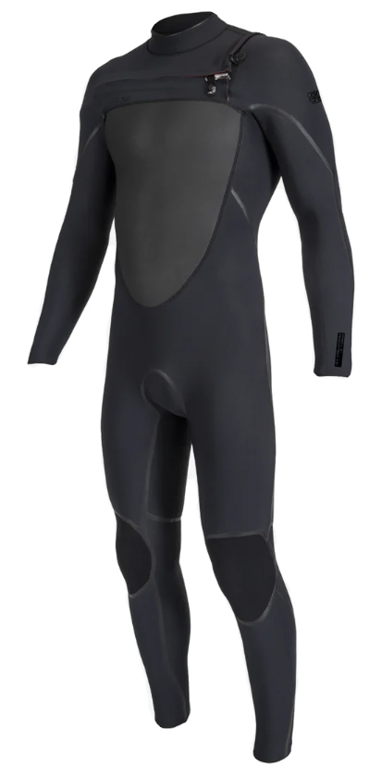
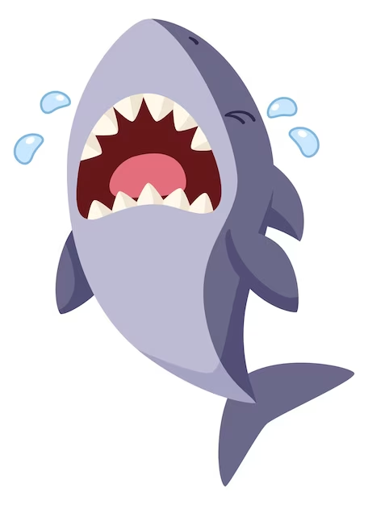

SOLUTION! : PROTECTION NEOPRENE
Dive Safe, Swim Smart – Armor Up Against Sharks!

Slide 6
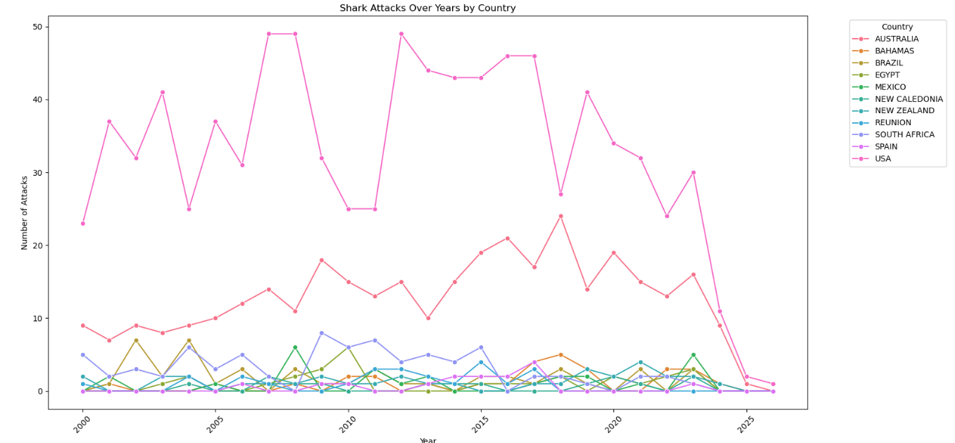
Identifying the Optimal Business Location
USA and Australia consistently report the highest number of shark attacks since 2000.
USA accounts for 48% of global shark attacks, Australia follows with 20%.
USA
Australia

Slide 7
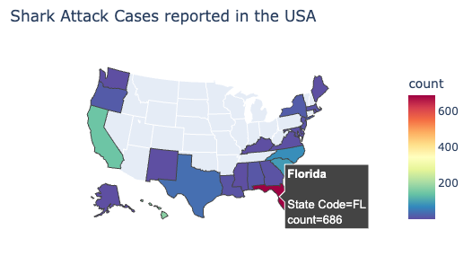
Identifying the Optimal Business Location
Shark attacks predominantly occur in coastal areas across the USA
Florida emerging as the most significant hotspot
Business Implications: Business potential on high-tourism coastal areas such as Miami Beach, Daytona Beach, and the Florida Keys

Slide 8
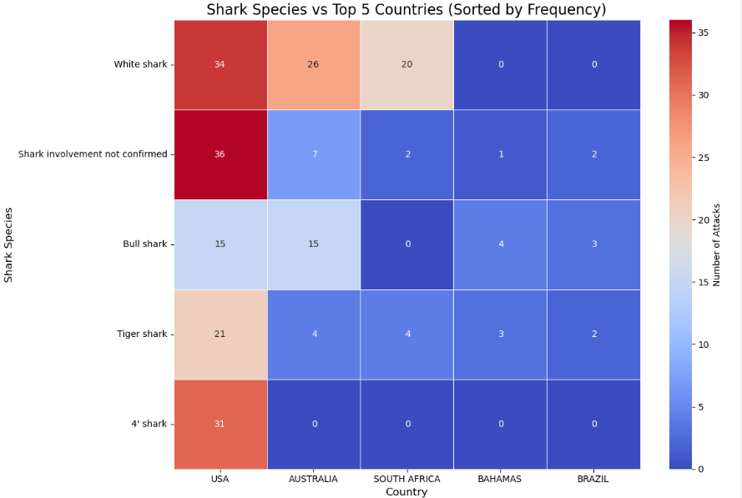
Shark Species Associated with Shark Attacks
​​
White Sharks are the most dangerous species, frequently encountered in attacks.
Bull Sharks and Tiger Sharks also contribute significantly to shark attack incidents.
Business Implications:
Focus marketing and distribution in regions where these species are prevalent.
Emphasize the protective features of the swimsuit against these specific sharks.

Slide 9
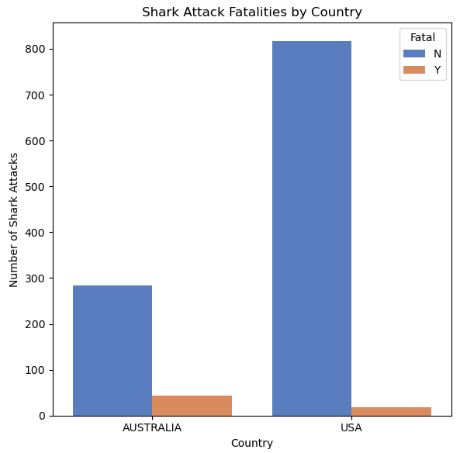
Fatal Attacks Data
Country | Fatal | Fatal Count
AUSTRALIA | No | 284
 | Yes | 43
USA | No | 816
 | Yes | 18
Pivot Table values

Slide 10
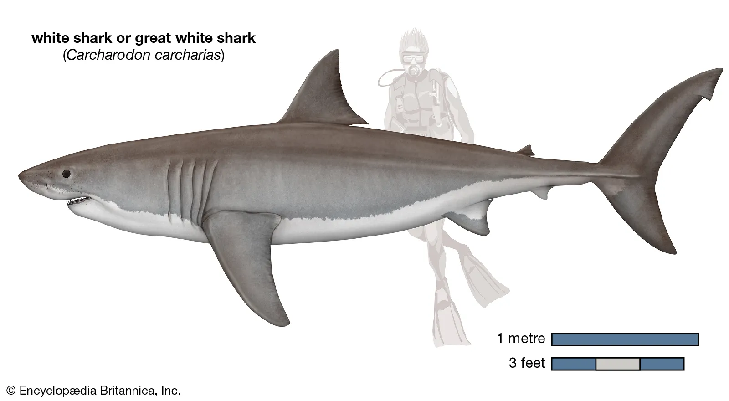
Shark Attack facts
Last 25 Years facts:
White shark is the most dangerous shark: 101 reported attacks
34 of those 101 attacks happened in USA and Australia
24 of them ended being mortal

Slide 11
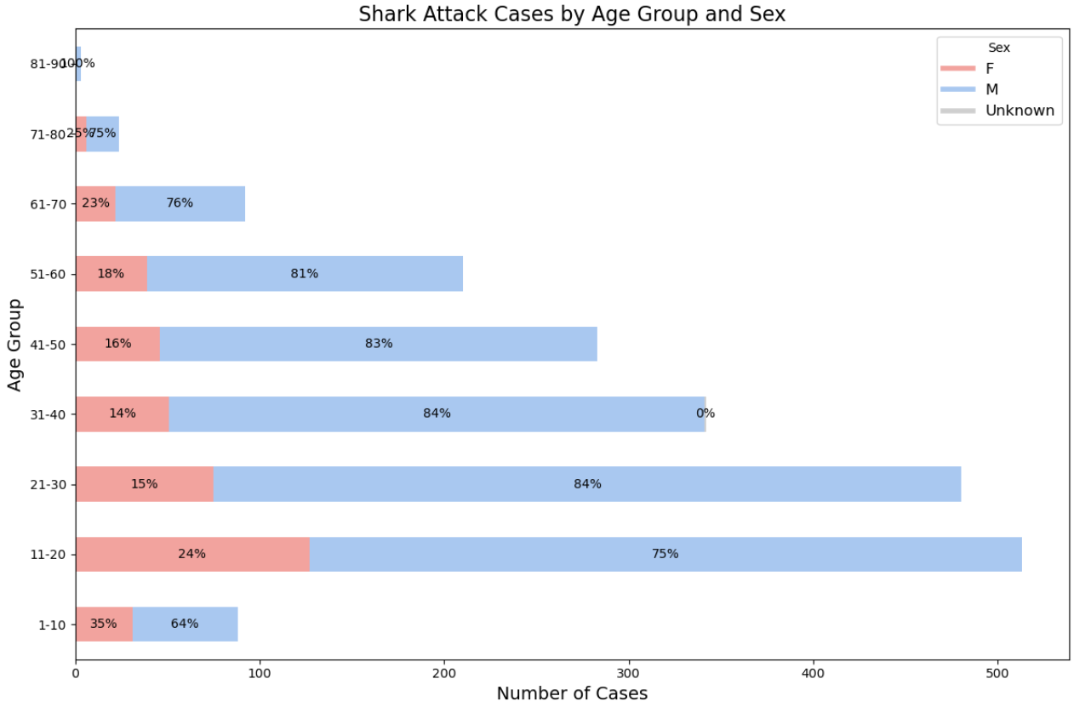
Shark Attack Cases by Age Group and Sex
Business Implications:
The highest frequency of shark attacks on 11-20 and 21-30 age groups → Target groups
Males are consistently reported to have more shark attack cases in all groups → Unisex/Male
Conclusions:
Offer teenager and adult sizes,
Unisex and Male models

Slide 12
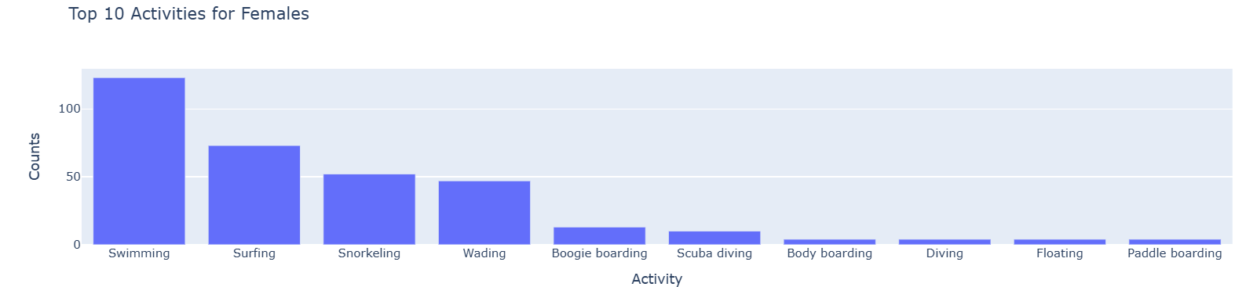
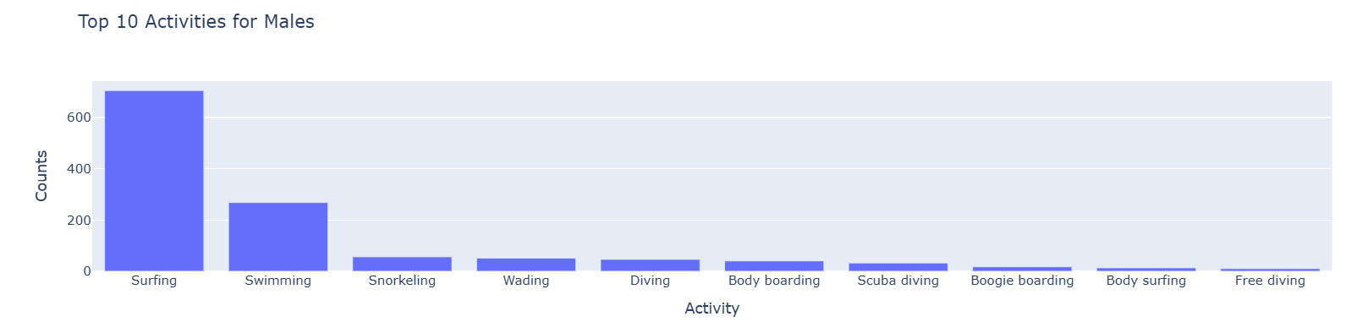
Shark Attack Cases by Sex and activity
We see that the most common activity among men is surfing, while the activity among women is divided between surfing, swimming and snorkeling.
Business Implications:
Product has to be lightweight and it has to be prepared for every kind of movement

Slide 13
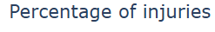
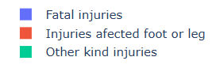
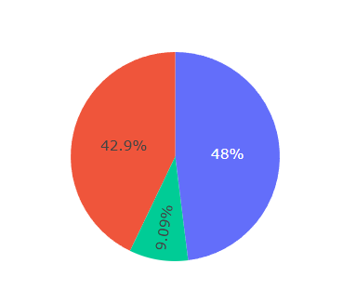
Shark Attack Cases by Type of injury
For the total injuries, only 9% were fatal
Almost 50% of the injuries has several damage in feet or legs
Business Implications:
Our product needs to focus on protect, especially, feet and legs.

Slide 14
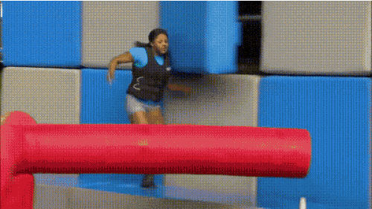
Major Obstacle
Dealing with inconsistent formatting in critical columns, especially the Age field.
Many entries included ranges (e.g., "12 and 20," "55 to 60," "20 & 25") or non-standard formats, making it difficult to perform accurate analysis.
Solution:
Applied regex to identify patterns in the strings, such as ranges or numeric values.
Calculated the average of the two numbers for ranges.
Extracted and rounded the first numeric value when no range was present.

Slide 15
Conclusion and Insights
The majority of shark attacks occurred near popular beaches in the USA and Australia.
Some unexpected findings (e.g., low fatality rates) contradicted common perceptions about shark attacks.
Most attacks were attributed to Great White Sharks.
Market Targeting: Focus marketing efforts for the swimsuit on high-risk groups (e.g., surfers, swimmers, and young males) in regions like the USA and Australia.
Florida (USA) as prime market for protective swimwear.
Product Development: lightweight, prepare for all kind of activities and focus on the protection of feet and legs

Slide 16

Shark Attack Project
Group 2
Victor | Rebecca | Angel | Sandra

